Slide 1
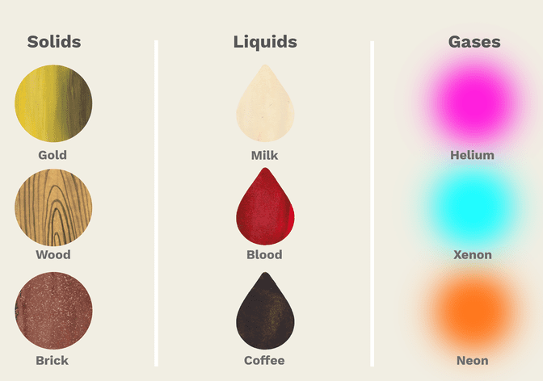
Types of Solids
Solids
liquids
Gases
Plasmon* (not within the course)
* A plasma is a hot ionized gas consisting of approximately equal numbers of positively charged ions and negatively charged electrons. The characteristics of plasmas are significantly different from those of ordinary neutral gases

Slide 2
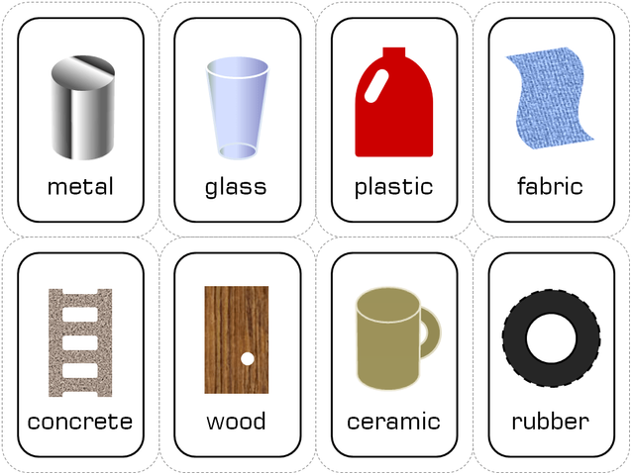
Solids used in our daily life

Slide 3
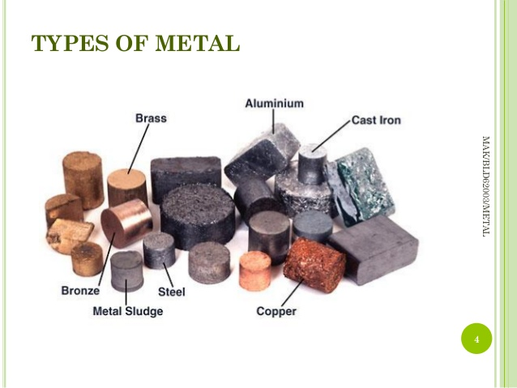
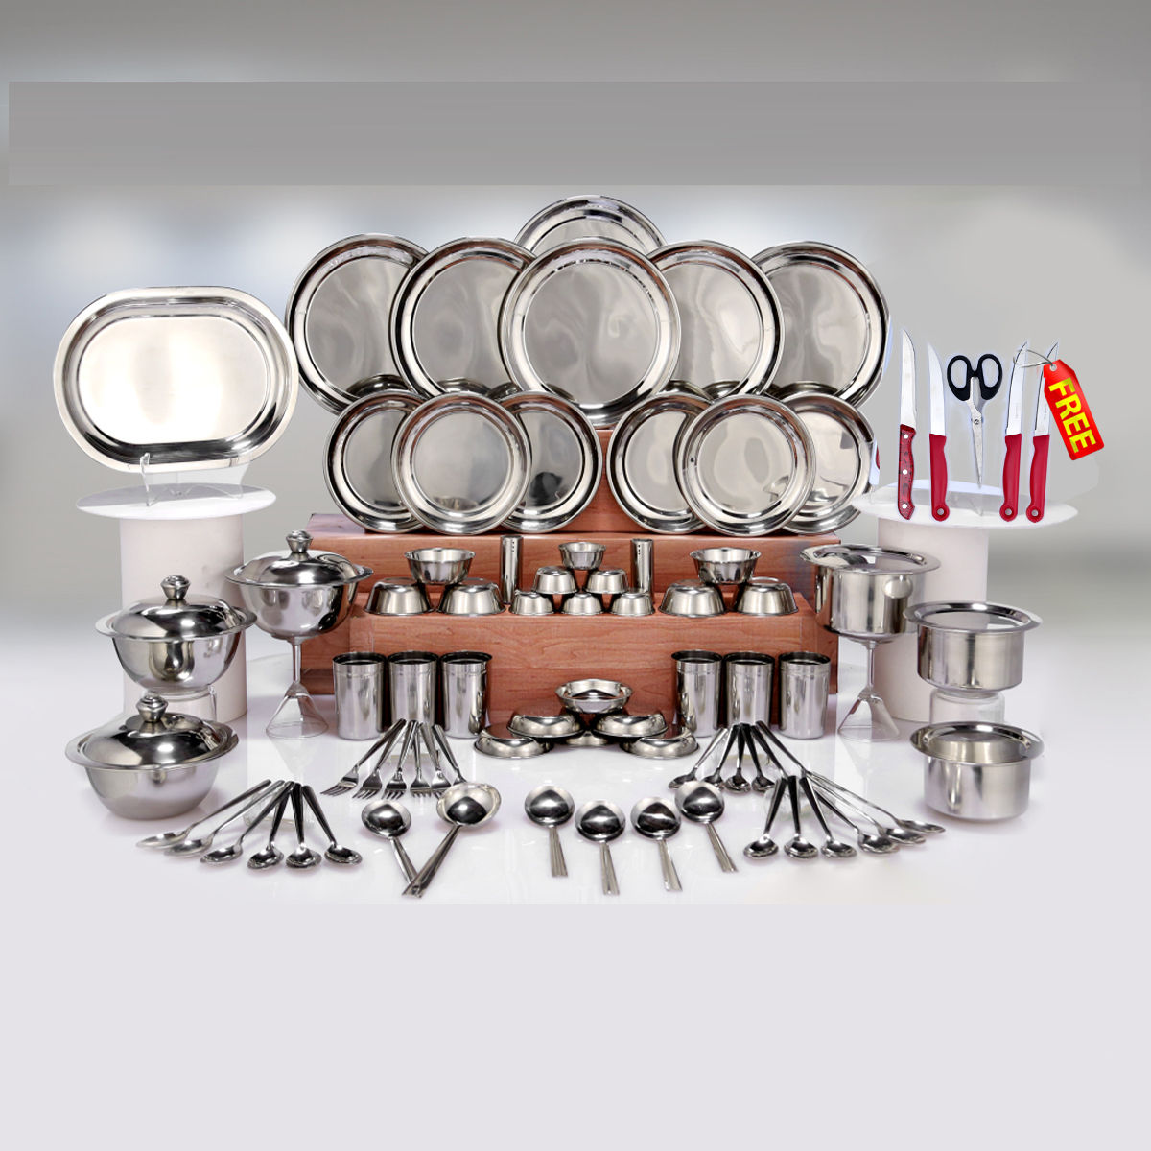
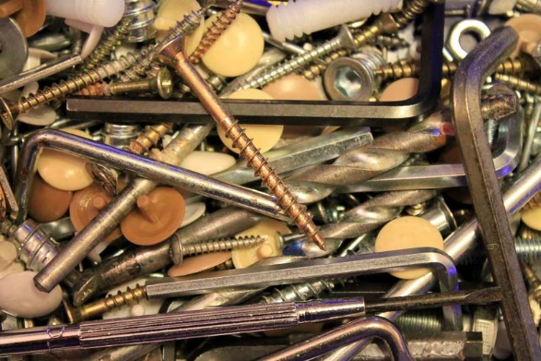
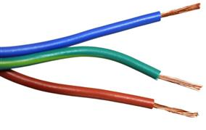

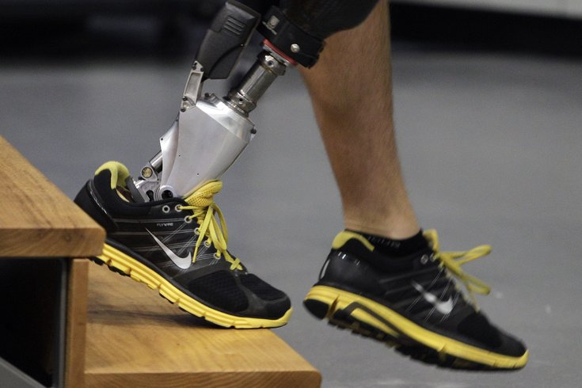
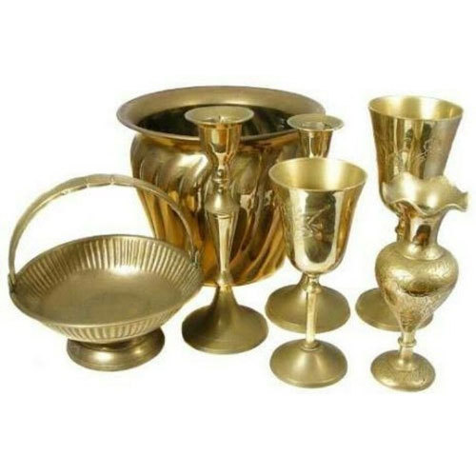
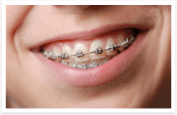
Types of Metals

Slide 4

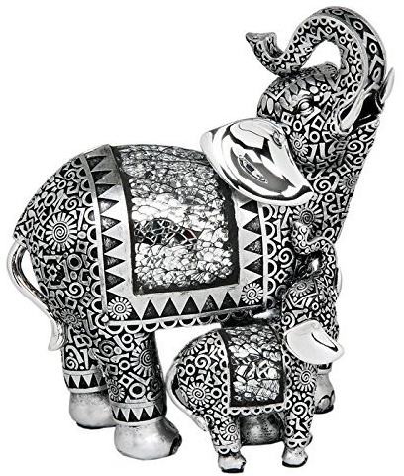
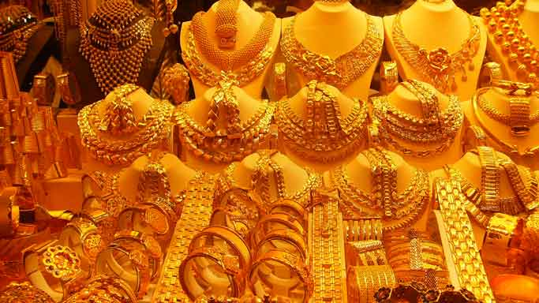
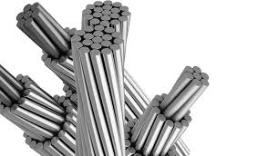
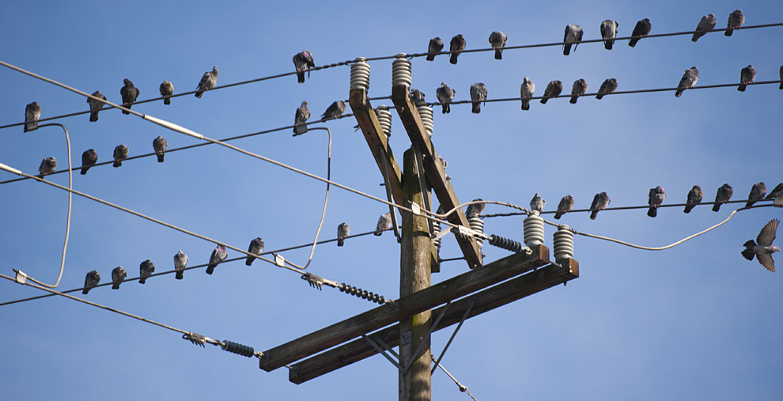
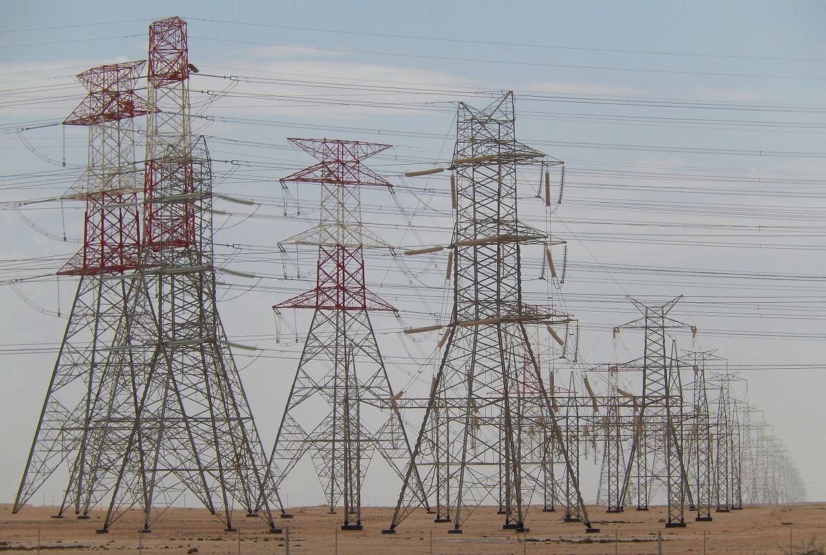
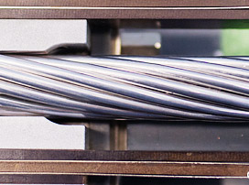

Slide 5
Solids
Crystalline
Non-crystalline (Amorphous)
Any solid having orderly three dimensional arrangement of atoms is called crystalline solid or crystal.
e.g. Salt (NaCl), Iron, Aluminium, Gold, Silver
Any solid consists of random arrangements of atoms is called amorphous solid.
e.g. glass, polymers

Slide 6
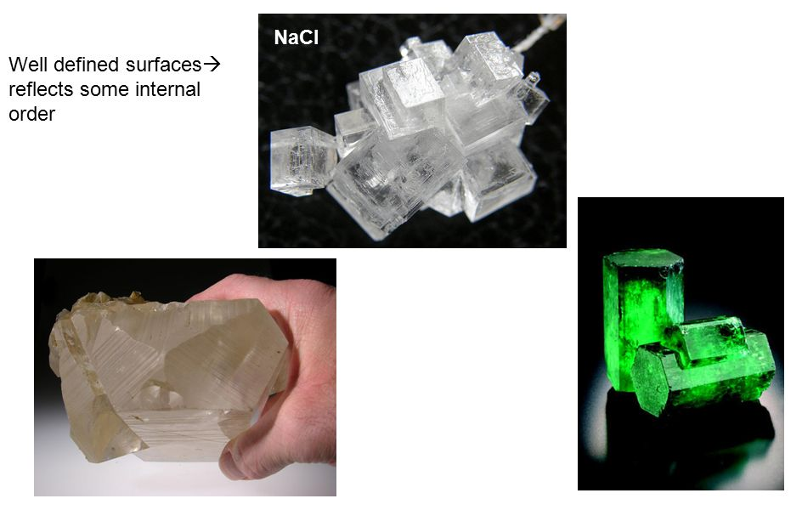
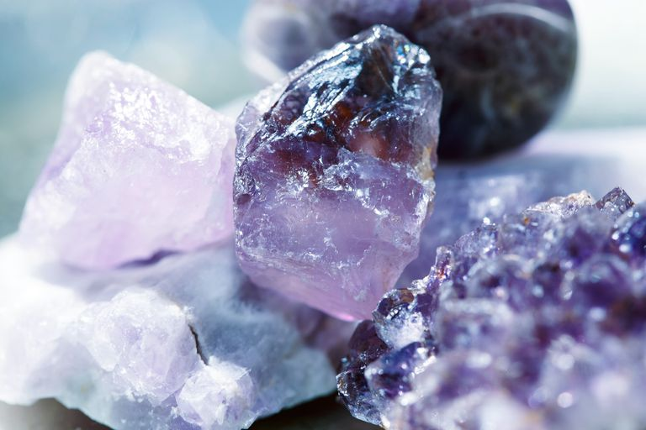
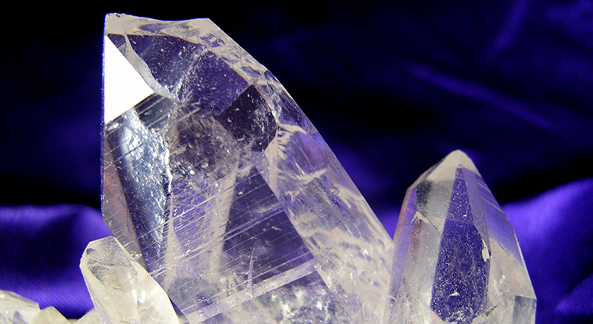

Slide 7
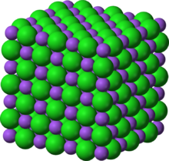
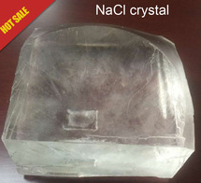

Slide 8
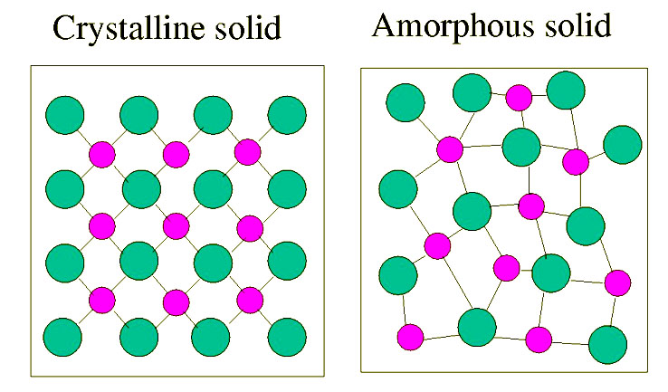

Slide 9
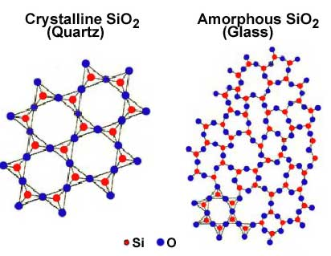
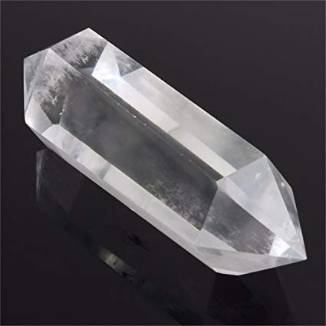
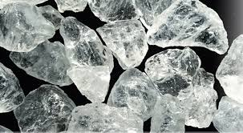
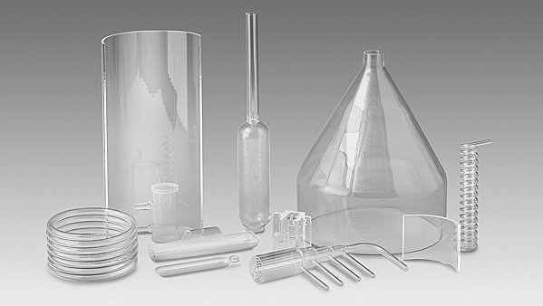

Slide 10
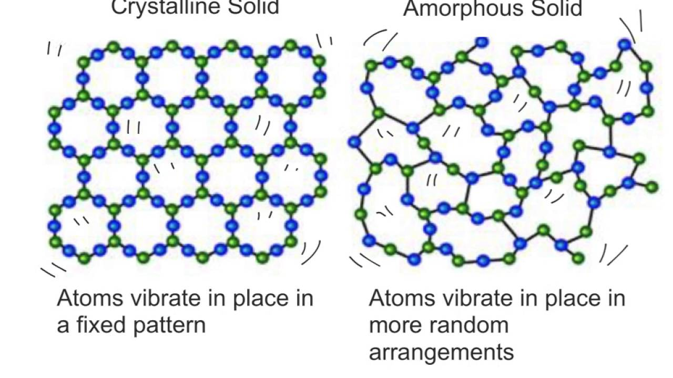

Slide 11
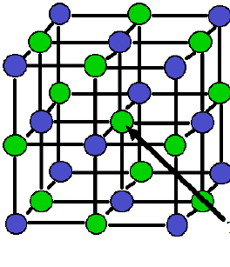

Slide 12
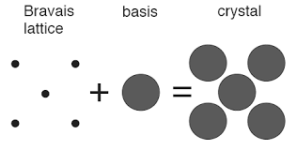
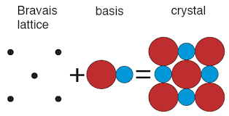
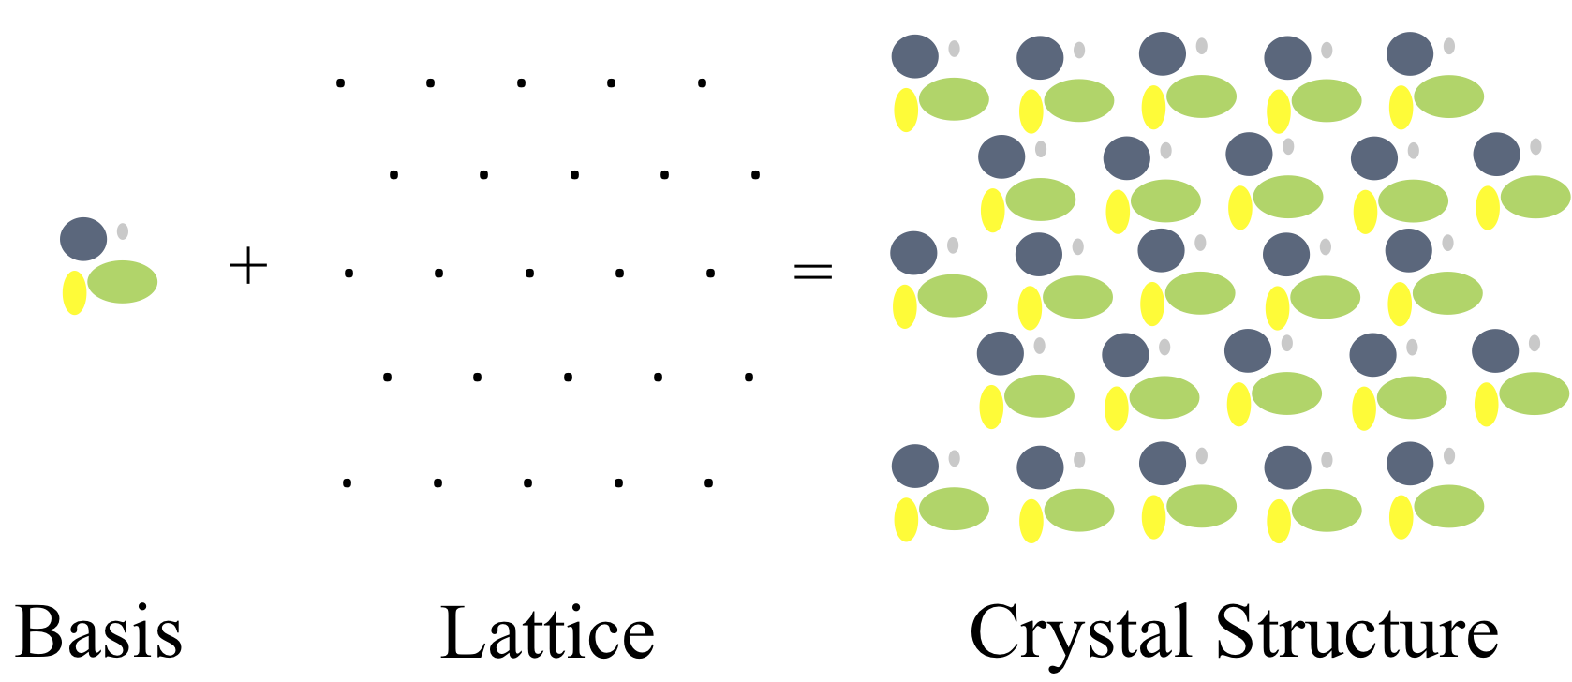
Crystal Structure = Space Lattice + Basis
Basis attached to each lattice point called crystal structure
The number of atoms in the basis may be one or more than one

Slide 13
Space lattice:
A regular geometrical arrangement of points in space is called space lattice
One dimensional lattice
Two dimensional lattice
Three dimensional lattice
Lattice constant or lattice parameter:
The distance between two identical lattice points in one direction is called lattice constant or lattice parameter.

Slide 14
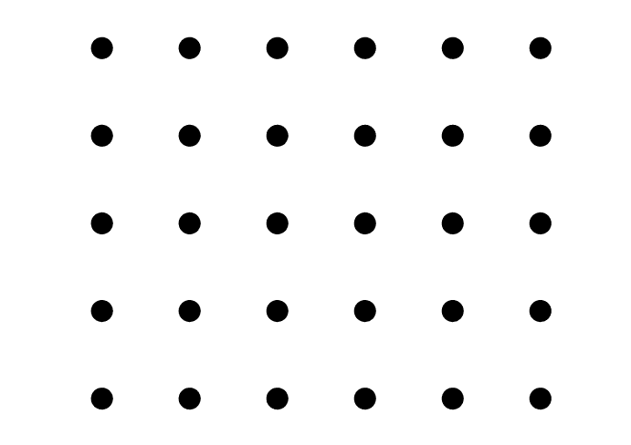

Slide 15
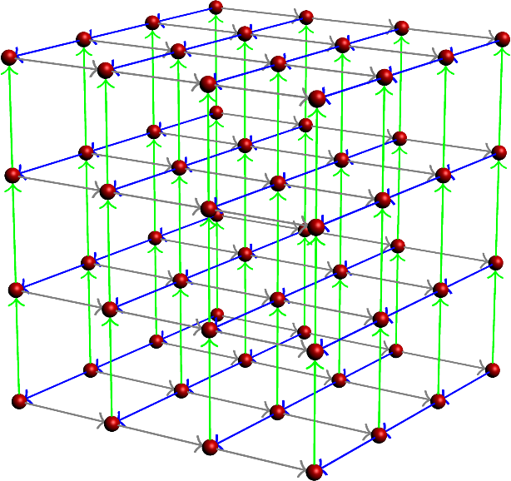

Slide 16
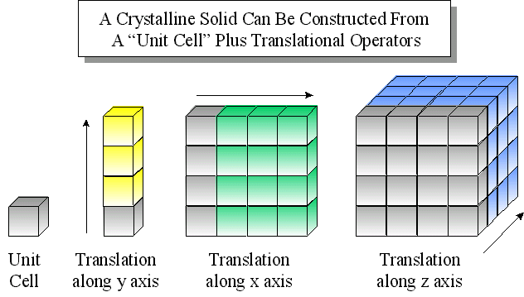

Slide 17
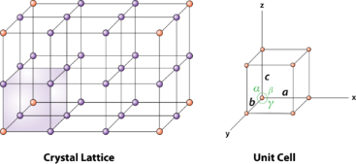
Unit cell:
The smallest geometrical entity whose repetition gives the crystal is called unit cell

Slide 18
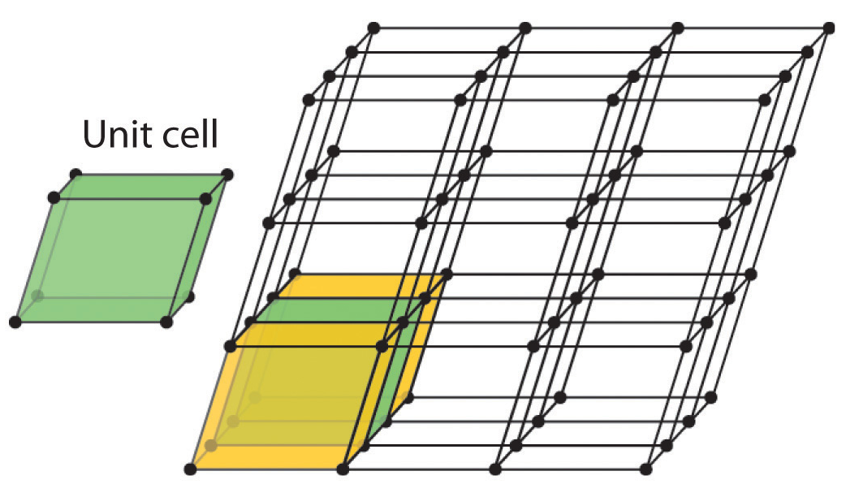

Slide 19
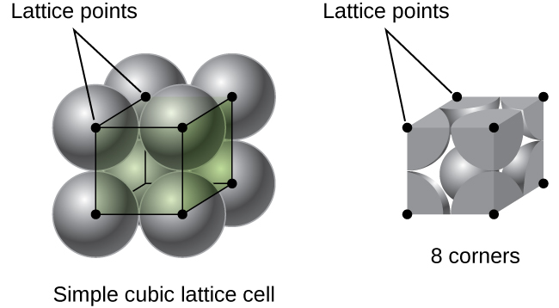

Slide 20
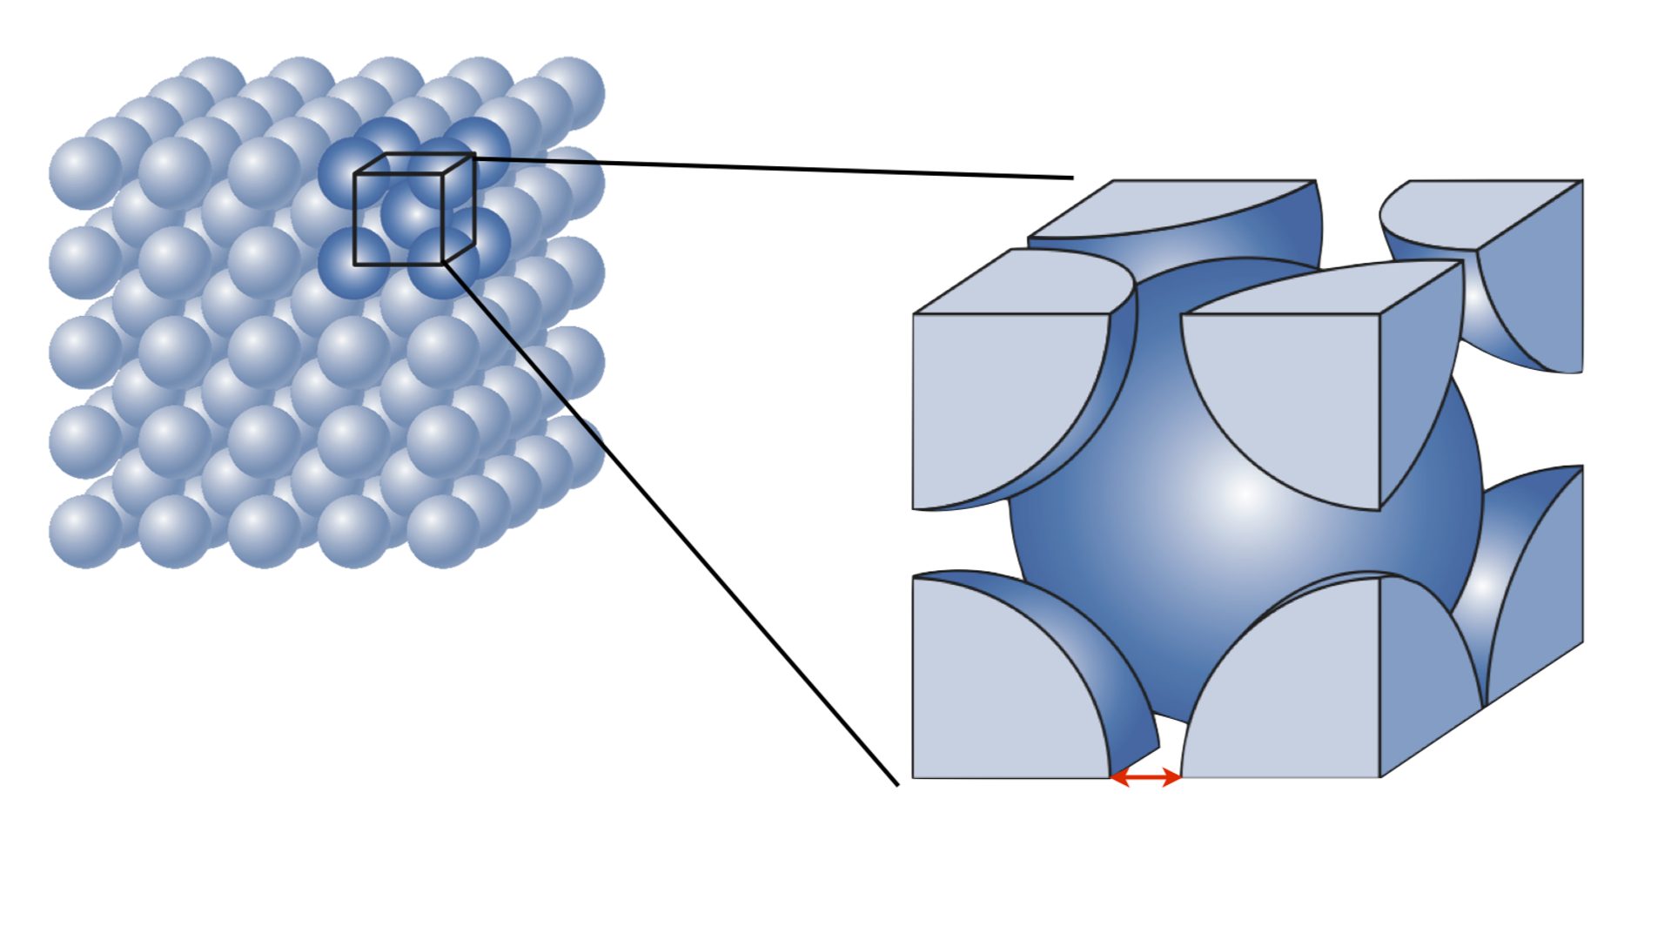
BCC

Slide 21
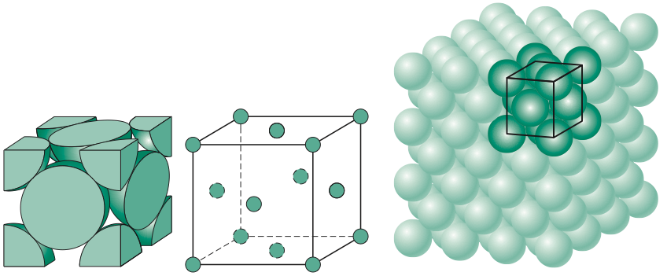
FCC

Slide 22
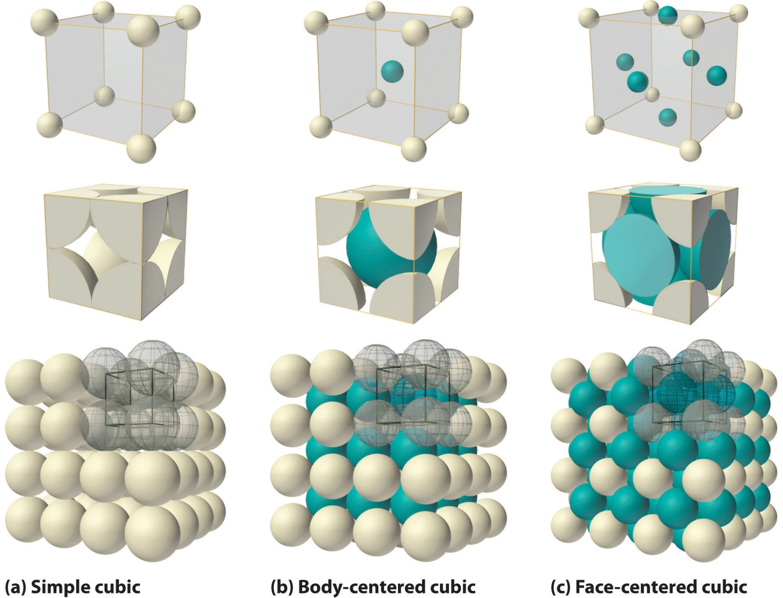

Slide 23
Primitive cell
A minimum volume unit cell and has only one lattice point it is called primitive cell.
e.g simple cubic (SC)
Non-Primitive cell
A minimum volume unit cell and has more than one lattice point it is called non-primitive cell. The primitive cell represented by a symbol is “P”
e.g. Body centered cubic (BCC), Face centered cubic (FCC), Base centered or end centered.

Slide 24
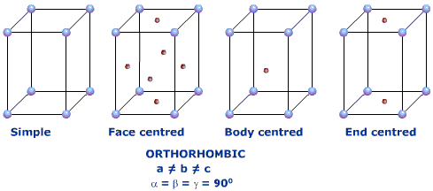
Unit cell | Type | Symbol
Simple cubic | Primitive | P
Body centered cubic | Non-primitive | I
Face centered cubic | Non-primitive | F
End centered or base centered | Non-primitive | C
Body centered cubic (BCC)
Face centered cubic (FCC)
Base centered or end centered
Primitive

Slide 25
Crystal Systems
System | Axis length and Angles | Examples
Cubic | a = b = c, α = β = γ = 90° | Au, Ag, Fe
Tetragonal | a = b ≠ c, α = β = γ = 90° | In, Pa
Orthorhombic | a ≠ b ≠ c, α = β = γ = 90° | Bi, Sb, As
Rhombohedral (or Trigonal) | a = b = c, α = β = γ ≠ 90° | SiO₂, CaCO₃
Hexagonal | a = b ≠ c, α = β = 90° and γ = 120° | Se, Te
Monoclinic | a = b ≠ c, α = γ = 90° ≠ β | Na₂SO₄, CaSO₄
Triclinic | a ≠ b ≠ c, α ≠ β ≠ γ ≠ 90° | CuSO₄, K₂Cr₂O₇

Slide 26
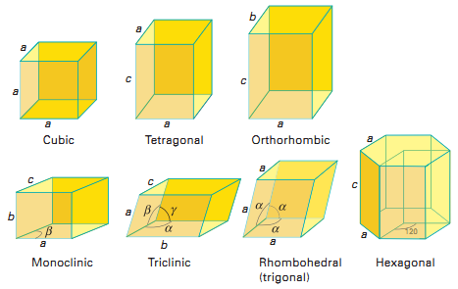

Slide 27
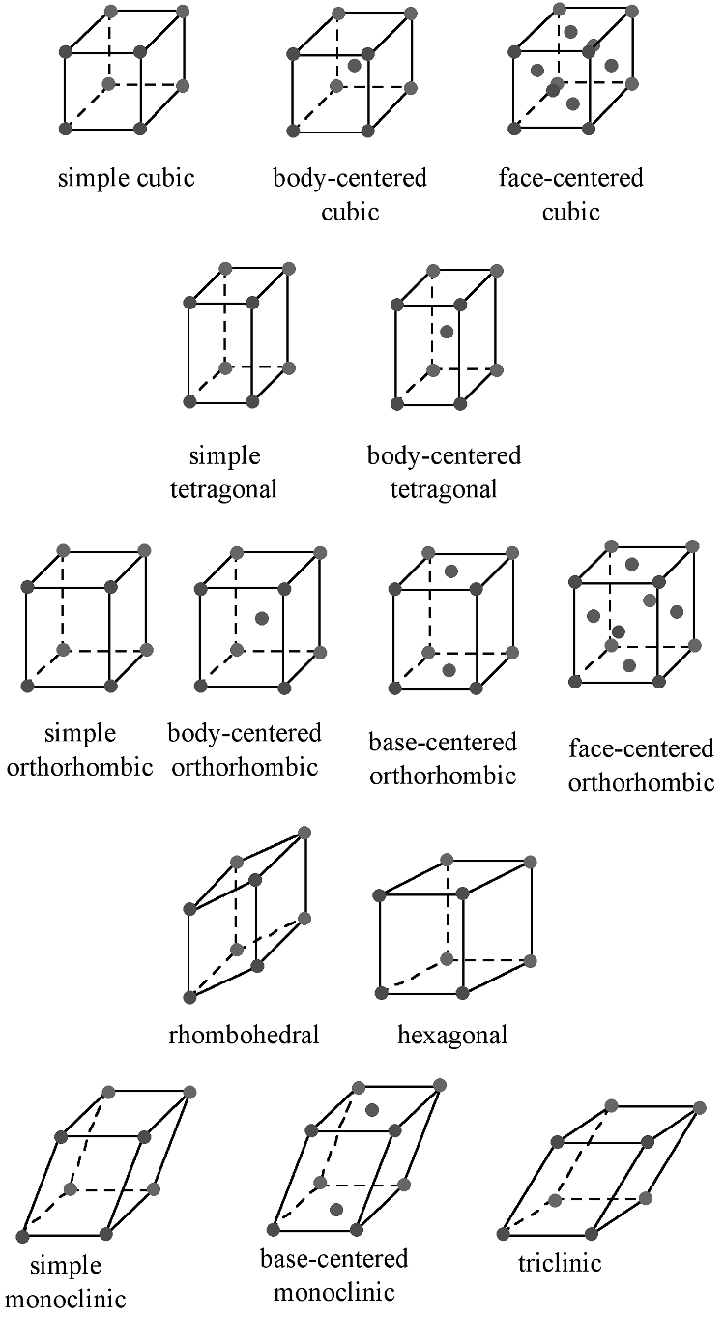
The Bravais lattice are the distinct lattice types which when repeated can fill the whole space.
14 Bravais Lattices

Slide 28
Bravais Lattice
System | Axis length and Angles | Bravais Lattice | Symbol
Cubic | a = b = c, α = β = γ = 90° | Simple Body centered Face centered | P I F
Tetragonal | a = b ≠ c, α = β = γ = 90° | Simple Body centered | P B
Orthorhombic | a ≠ b ≠ c, α = β = γ = 90° | Simple Body centered Face centered End centered | P I F C
Rhombohedral (or Trigonal) | a = b = c, α = β = γ ≠ 90° | Simple | P
Hexagonal | a = b ≠ c, α = β = 90° and γ = 120° | Simple | P
Monoclinic | a = b ≠ c, α = γ = 90° ≠ β | Simple End centered | P C
Triclnic | a ≠ b ≠ c, α ≠ β ≠ γ ≠ 90° | Simple | P

Slide 29
Coordination number
The number of equidistant nearest neighbour atoms in crystal.
SC = 1
BCC = 8
FCC = 12
Number of atoms or lattice points in unit cell
SC = 1
BCC = 2
FCC = 4

Slide 30
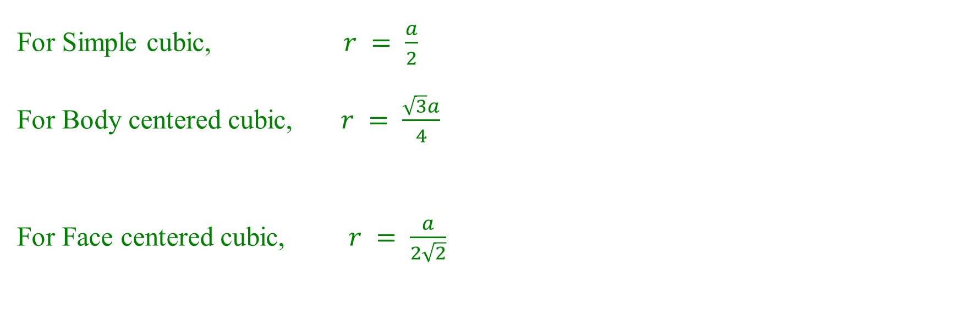
Nearest neighbor distance
The distance between two centers of neighbouring atoms is called nearest neighbour distance
For Simple cubic, $r = \frac{a}{2}$
For Body centered cubic, $r = \frac{\sqrt{3}a}{4}$
For Face centered cubic, $r = \frac{a}{2\sqrt{2}}$

Slide 31
Primitive unit cell or simple cubic
r
a
r
a

Slide 32
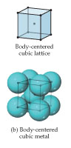
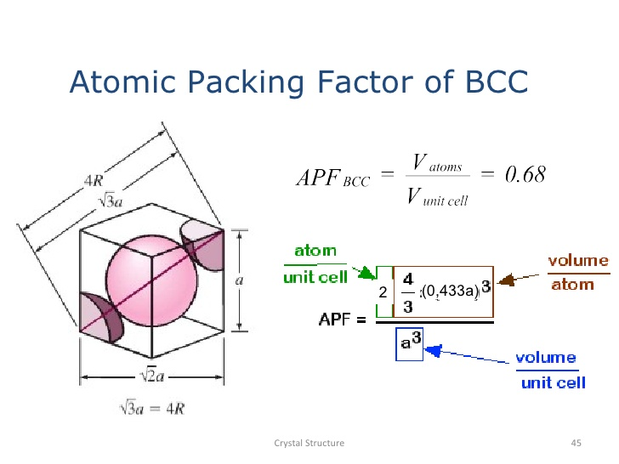
Body centered cubic

Slide 33
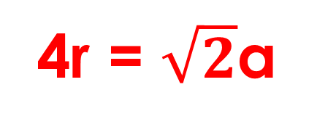
Face centered cubic
4r = $\sqrt{2}$a
a
a

Slide 34
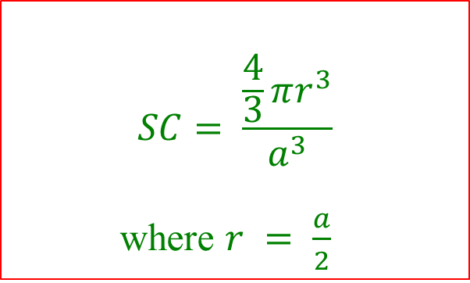
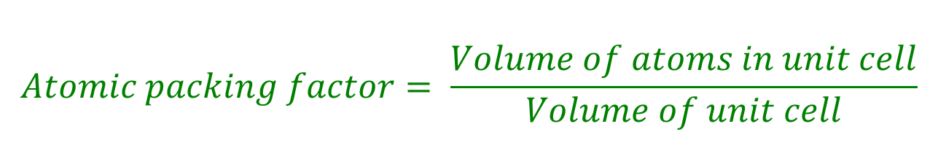
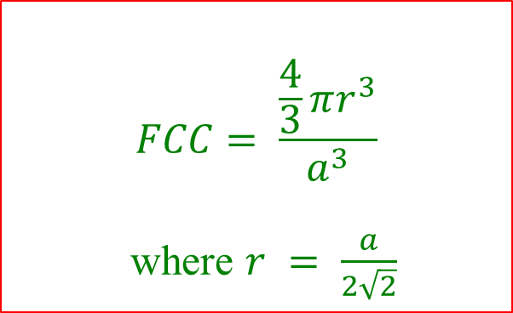
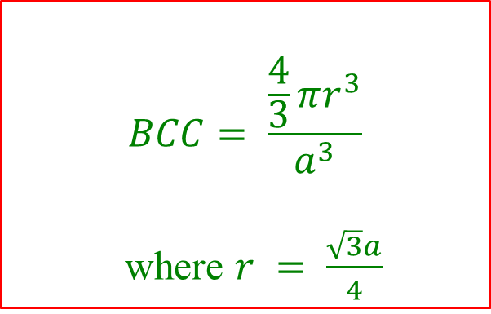
Atomic packing factor
$$Atomic packing factor= \frac{Volume of atoms in unit cell}{Volume of unit cell}$$
$$SC= \frac{\frac{4}{3}πr^{3}}{a^{3}}$$
where $r = \frac{a}{2}$
$$BCC= \frac{\frac{4}{3}πr^{3}}{a^{3}}$$
where $r = \frac{\sqrt{3}a}{4}$
$$FCC= \frac{\frac{4}{3}πr^{3}}{a^{3}}$$
where $r = \frac{a}{2\sqrt{2}}$

Slide 35

 | Simple Cubic | Body centered cubic | Face centered cubic
No. of atoms or lattice points per unit cell | 1 | 2 | 4
No. of nearest neighbors (Coordination number) | 6 | 8 | 12
Nearest neighbor distance | a | $$\frac{\sqrt{3}a}{2}$$ | $$\frac{a}{\sqrt{2}}$$
Packing fraction | $$\frac{π}{6}=0.52$$ | $$\frac{\sqrt{3}π}{8}=0.68$$ | $\frac{\sqrt{2}π}{6}=0.$74

